Slide 1
Detailed and adaptive surface reconstruction of implicit models
Bernhard Manfred Gruber

Slide 2
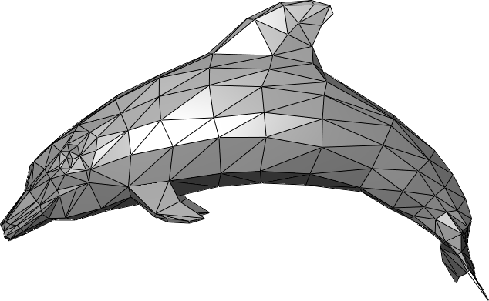
What are implicit models?
Explict surface models
Implict surface models
Parametric
Functional (iso surface)
Boundary Representation
Constructive Solid Geomtry
Sweeps
...
http://en.wikipedia.org/wiki/Triangle_mesh#mediaviewer/File:Dolphin_triangle_mesh.png

Slide 3
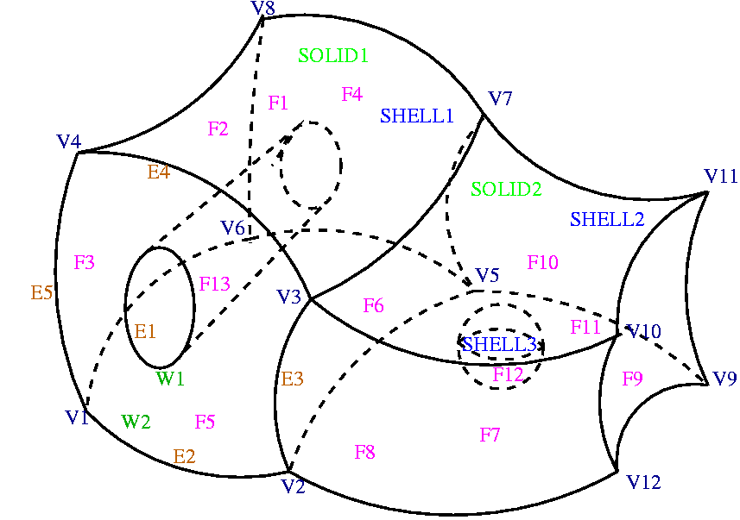
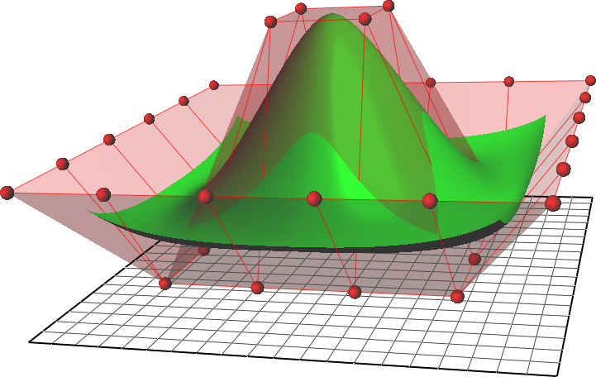
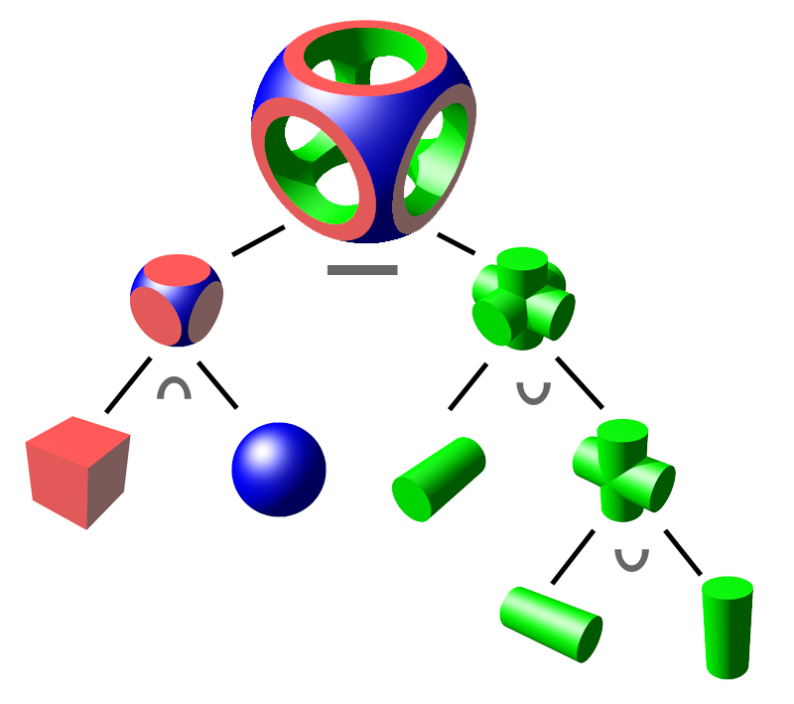
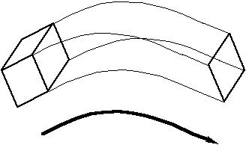
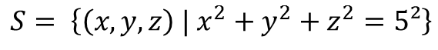
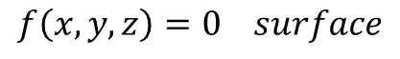
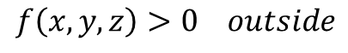
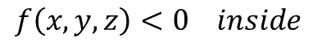
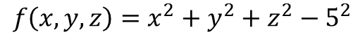
What are implicit models?
$$f\left(x, y, z\right)=x^{2}+y^{2}+z^{2}−5^{2}$$
$$f\left(x, y, z\right)<0 inside$$
$$f\left(x, y, z\right)>0 outside$$
$$f\left(x, y, z\right)=0 surface$$
$$S= \left\{\left(x, y, z\right) | x^{2}+y^{2}+z^{2}=5²\right\}$$
http://en.wikipedia.org/wiki/Constructive_solid_geometry#mediaviewer/File:Csg_tree.png
https://www.ljll.math.upmc.fr/perronnet/mit/mit.html
http://de.wikipedia.org/wiki/Non-Uniform_Rational_B-Spline#mediaviewer/File:NURBS_surface.png
http://www.cs.cf.ac.uk/Dave/3DVG/IMAGES/sweep.gif

Slide 4

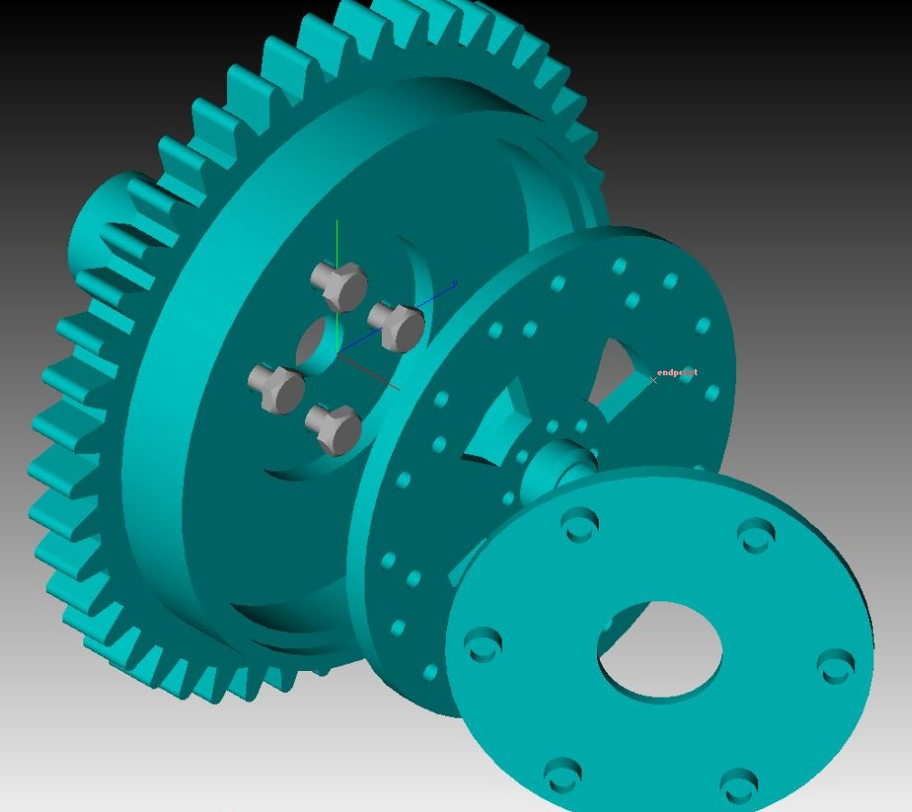
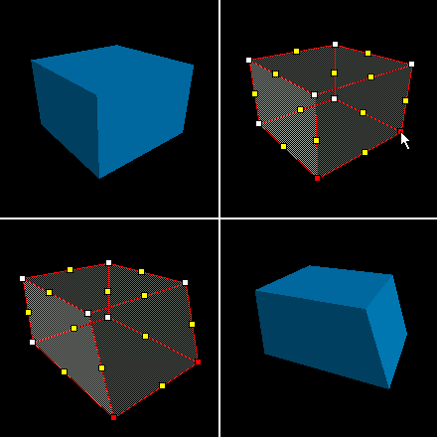
Motivation
Explicit surfaces
Implicit surfaces
Wide support
Render
Process
Store
Edit
Distribute
Sell
...
Exact
Expressive
Small memory
Ray tracing
...
https://www.khronos.org/news/logos
http://blog.bestsoftware4download.com/wp-content/uploads/2010/04/TurboCAD-MAC.jpg
https://developer.valvesoftware.com/w/images/2/29/VertexEdit1.png

Slide 5


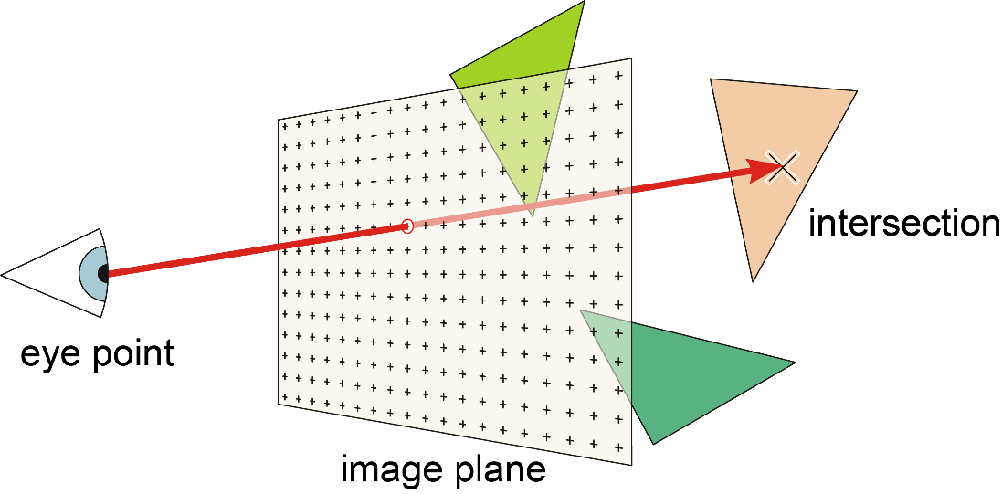
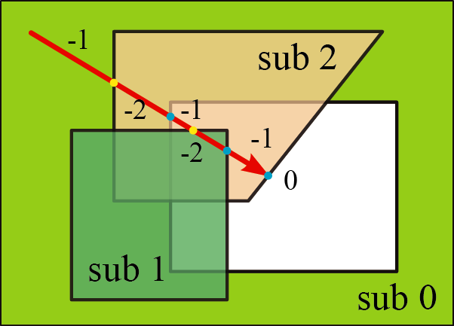
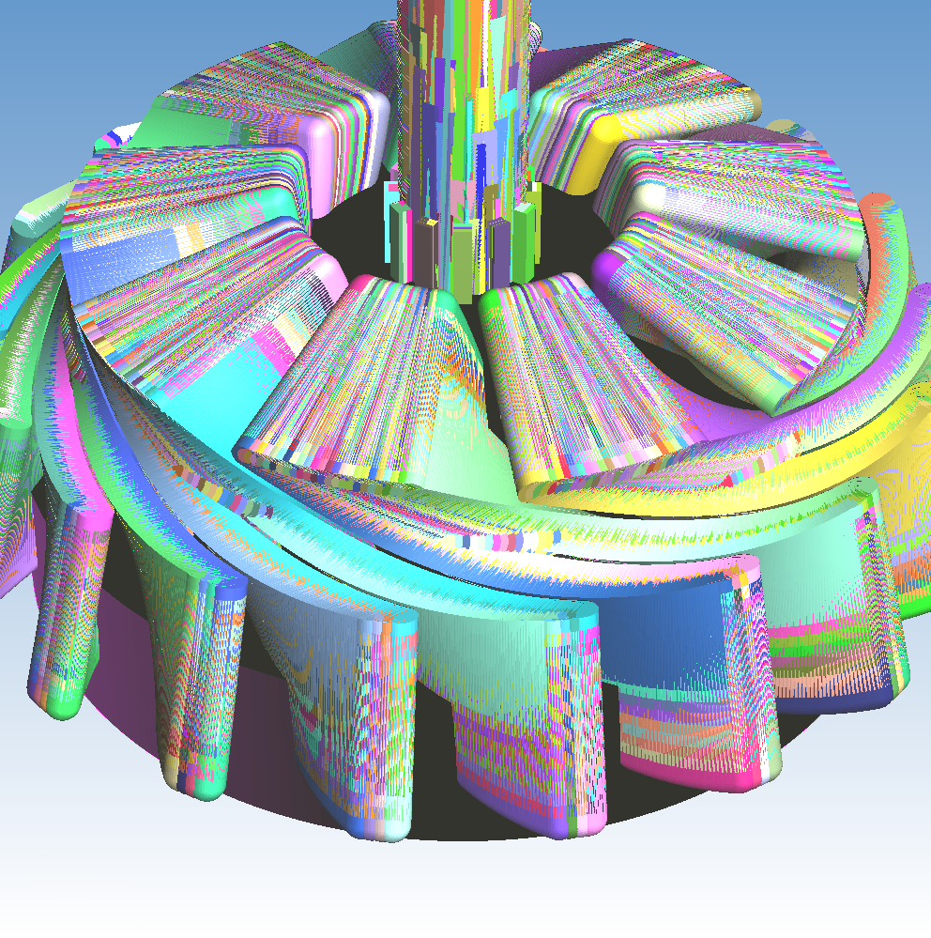
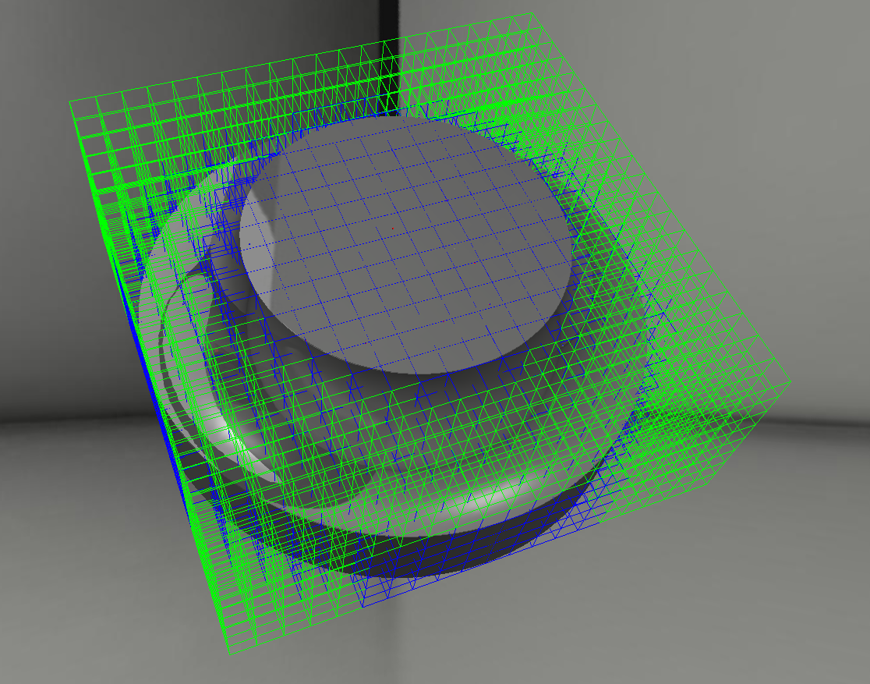
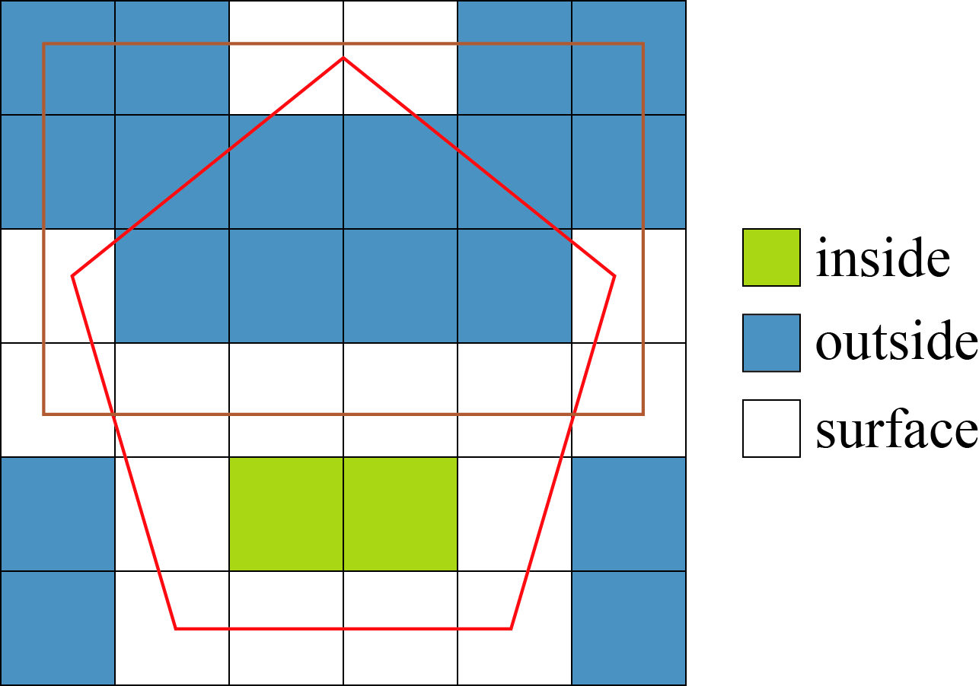
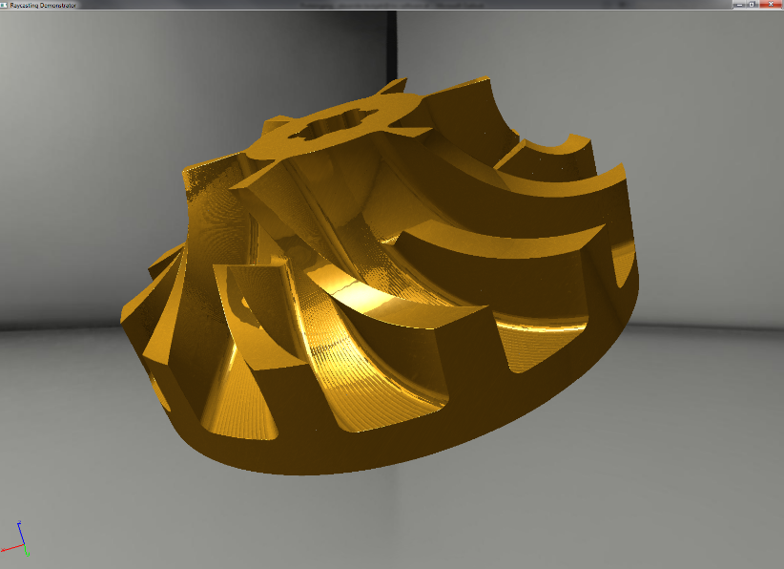
Previous work - Enlight

Slide 6
Problem statement
Surface mesh extraction from Enlight’s data model
Determine state of the art
Prototypic implementation and comparison runtime, memory, complexity, visual quality, errors, divergence, numeric, mesh quality, feature conservation, adaptivity
Intensive testing on selected models. Is there a "best" algorithm? Under which circumstances? How to select best suited algorithm?

Slide 7
Approaches
Direct intersection
Point cloud based
Voxel based
Dexel based

Slide 8
Direct intersection
Most naïve, probably most accurate
David Rosen, Seamless Intersection Between Triangle Meshes, 2008

Slide 9
Direct intersection

Slide 10
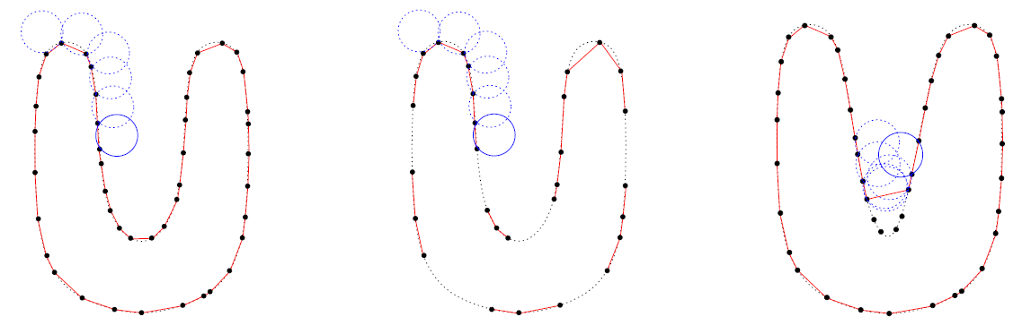
Point cloud based
Sample surface (using e.g. raycast), reconstruct surface from points
Fausto Bernardini et al., The ball-pivoting algorithm for surface reconstruction, 1999

Slide 11
Point cloud based

Slide 12
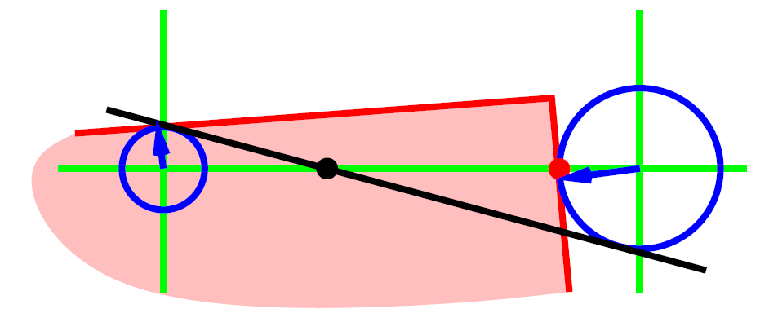
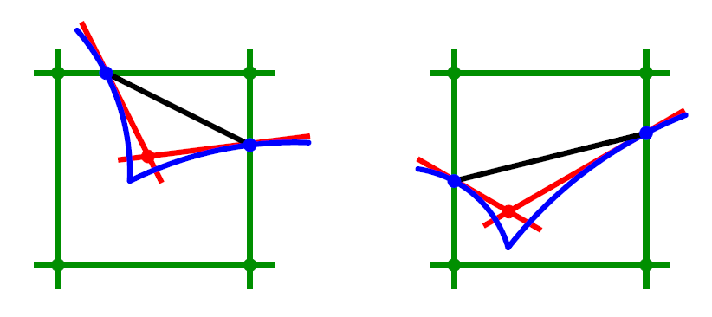
Voxel based
Leif Kobbelt et al., Feature sensitive surface extraction from volume data, 2001

Slide 13
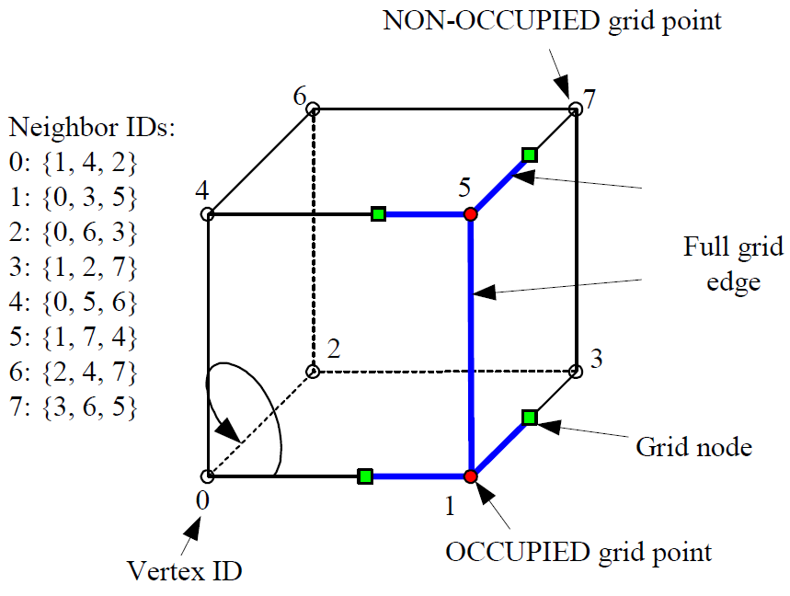
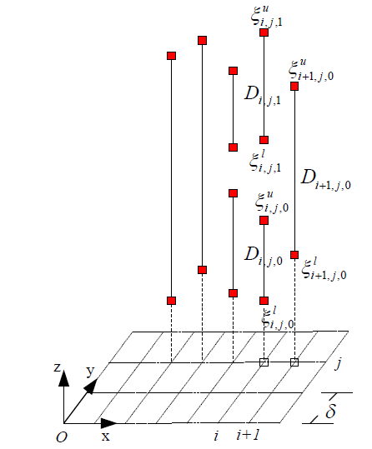
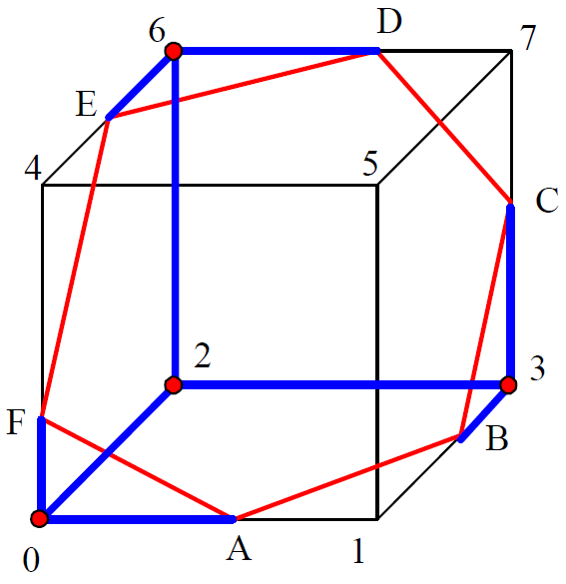
Dexel based
Yongfu Ren et al., Feature conservation and conversion of Tri-dexel volumetric models to polyhedral surface models for product prototyping, 2008

Slide 14
Goal
Implement presented approaches
Create appropriate test suite (models)
Evaluate algorithms
Try to find "best" algorithm or hybrid
Development on "best" algorithm will be continued at RISC …
Notes:
Criteria as in problem statement, maybe also parallelization

Slide 15
Schedule
Time | Milestone
October | DPR3: Technical lecture, infrastructure code, some test models
November | Exposè, direct triangle-triangle intersection
December | DPR3: Thesis introduction, point cloud based approaches
January | Voxel based approaches
February | Dexel based approaches
March | Comparing implementations, introductory and fundamental chapters
April/May | Implementation chapters, adjusting implementations, more test models
June | Finishing touches and submission

Slide 16
Thx

